Slide 1
Business Update- 2025

Slide 2
TNF S24 business summary
Stage | Qty | Remarks
No of new develop styles | 12 | All development samples has been delivered on time
No of c/o styles | 4
No of SMS styles | 11 | 639 pcs all SMS qty has been delivered on time
No of confirmed styles | 14 | The hit percentage from development to confirmed style is 83.33%
No of dropped styles | 2 | There were 2 styles dropped after Proto 1
Total Order qty: | 120794 | Already 1,18686 pcs shipped & 100% final inspection passed self & 3rd party together. Balance 2108 pcs will be shipped as per CRD.
Total FOB | $2,967,312 | ''Two million nine hundred sixty-seven thousand three hundred eleven dollars"

Slide 3
TNF F24 business summary
Stage | Qty | Remarks
No of new develop styles | 4 | All development samples has been delivered on time
No of c/o styles | 3
No of SMS styles | 4 | 184 pcs all SMS qty has been delivered on time
No of confirmed styles | 6 | Still the hit percentage from development to confirmed style is 75%, Since we didn’t received bulk order for one style.
No of dropped styles | 0 | But two styles has dropped before P1 stage/allocation
Total Order qty: | 50563 | Up to Feb'24 buy but we have another 8K projection qty for March buy of F24.
Total FOB | $1,763,773 | "One million seven hundred sixty-three thousand seven hundred seventy-three dollars"

Slide 4
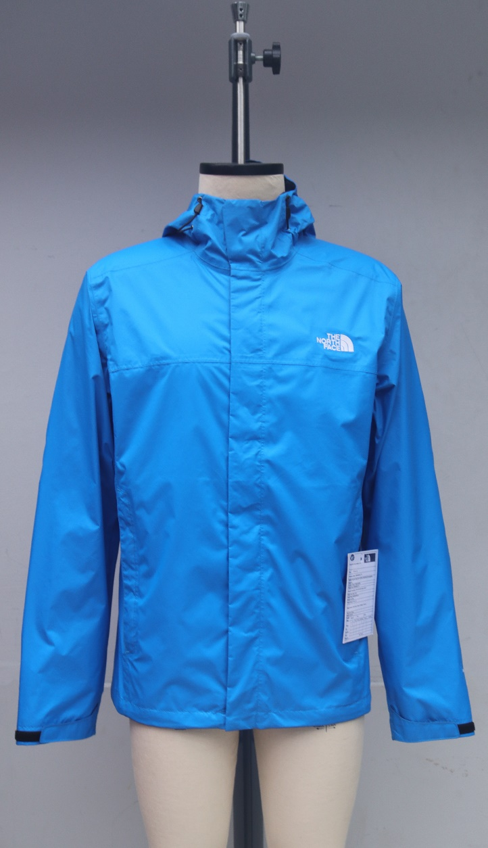
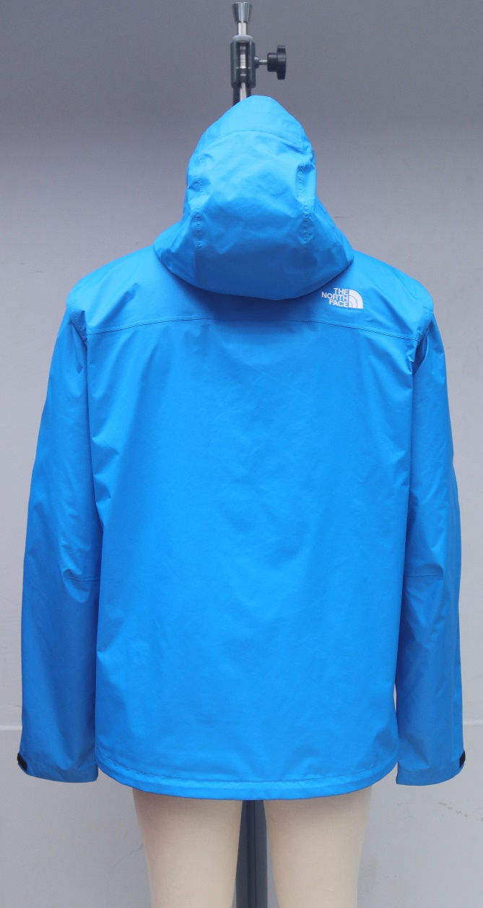
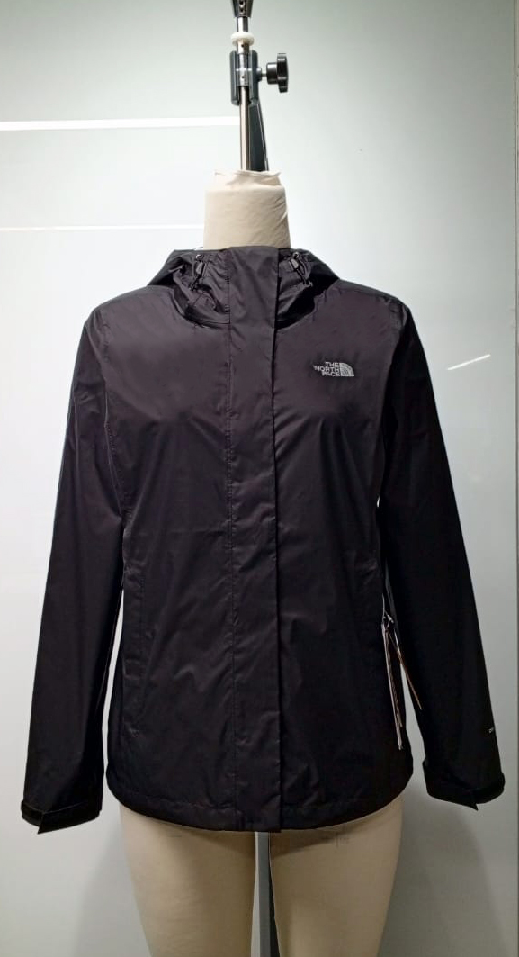
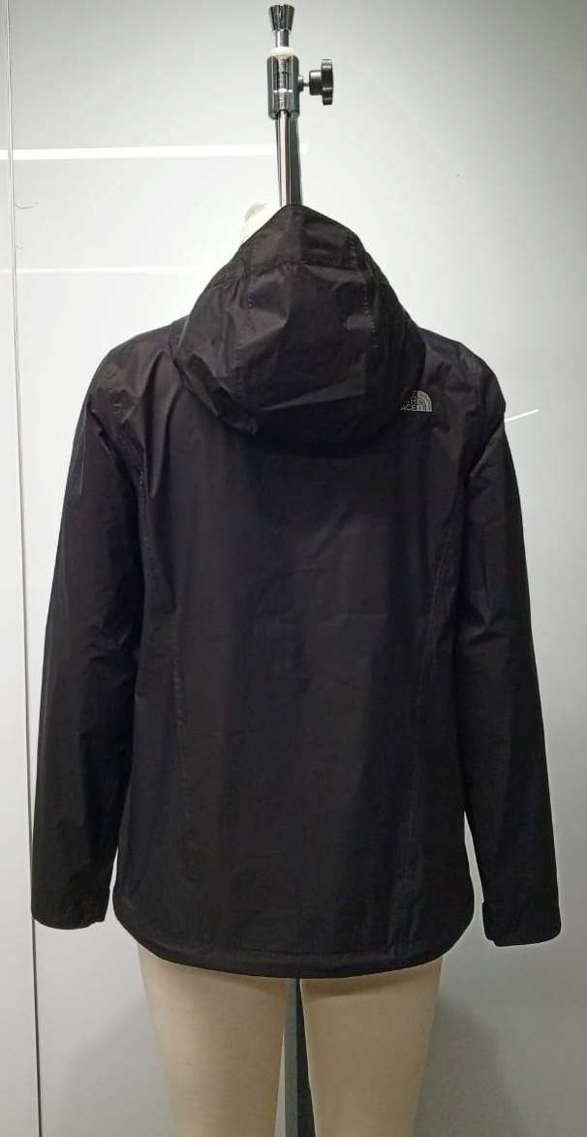
TNF S25 business Forecast
Stage | Qty | Remarks
No of new develop styles | 0
No of c/o styles | 2
Projection qty | 14725 pcs
Total FOB (Assumption) | $569,001
Style : A3LH4
Style : A3LH5

Slide 5
VPM
Jun’2023 VPM
Vendor Tire : Basic
Score : 41%
Rank : 43
Nov’2023 VPM
Vendor Tire : Core
Score : 57%
Rank : 19

Slide 6
TNF OTP
F23
SMS 100%
Bulk 100%
S24
SMS 100%
Bulk 99.2%
(0.08% delayed 1 wk for Strike on Nov’23)
F24
SMS 100%
Bulk 100% (till feb’24)

Slide 7
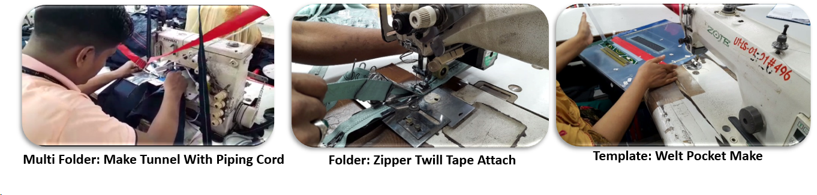
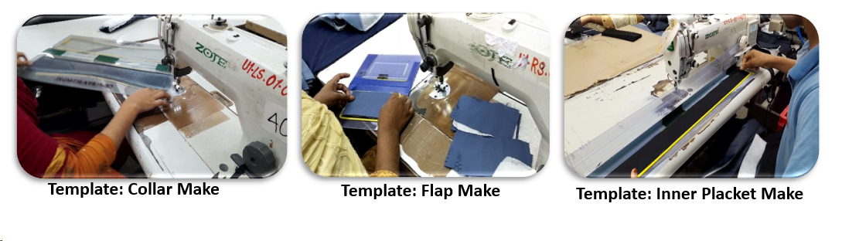
Debonair has dedicated team for TNF
Have a committed Merchandising team who ensure on time support with as per brand expectation.
We have dedicated R&D & CAD team along with CFT & QC for TNF. Also bought all required TNF mannequins for smooth working.
Have TNF experience/expertise in Production & Quality personnel in each department (Like Store, Cutting, Template, Sewing, Finishing etc.)
Debonair ’s In house Lab is already accredited by VF Asia.
Potential confidence:
Our entire team always try to handle the all procedure accurately & efficiently.
Individual Team are more proactive to execute and deal the brands expectations.
Continuous improvement
Debonair continuously work to close the gap in SMV by automation & innovation facilities.
Team are also working continuously to improve factory efficiency level through sustainable development & arranging all required training to increase the skills.

Slide 8
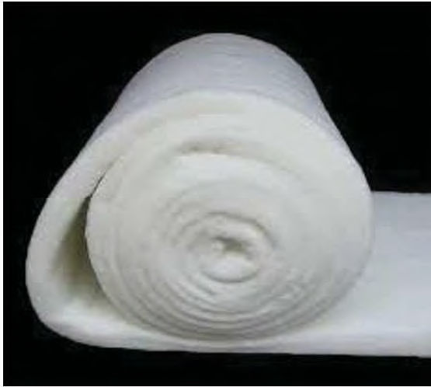
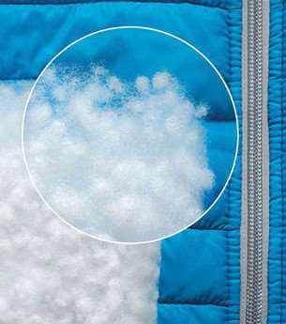
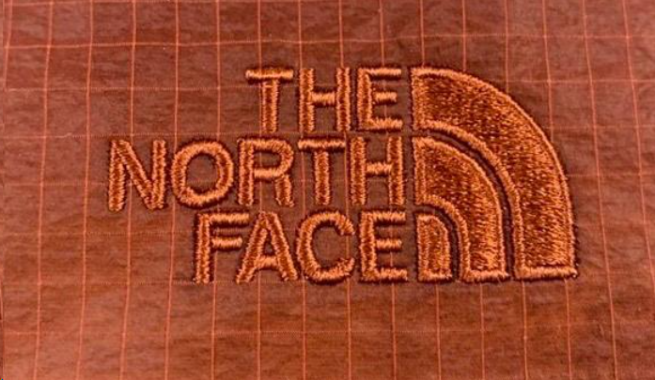
Debonair Insulation & other material has Nomination for VF brands
A remarkable success of Debonair that own insulations item (Synthetic down & padding) are now worldwide nominated for Timberland Brands.
Also Vans, Dickies & Supreme are using our own insulations.
Shine Embroidery has capability in various types of embroidery such as Regular Stitch, Sequin , Applique, Chenille, Tapping, Cording, Boring which are utilized for all brands like TNF, Timberland, Napapijri, Vans, Dickies and Supreme also.

Slide 9
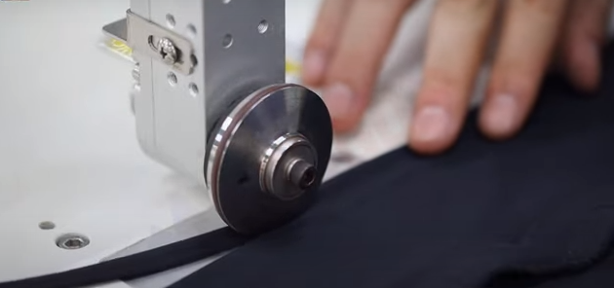
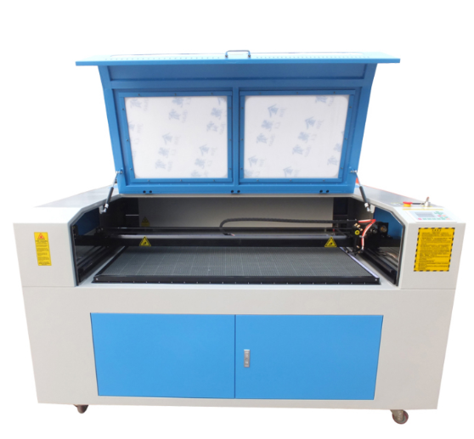
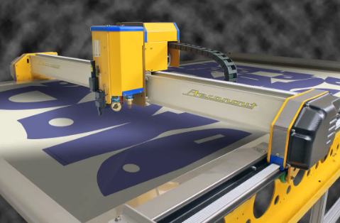
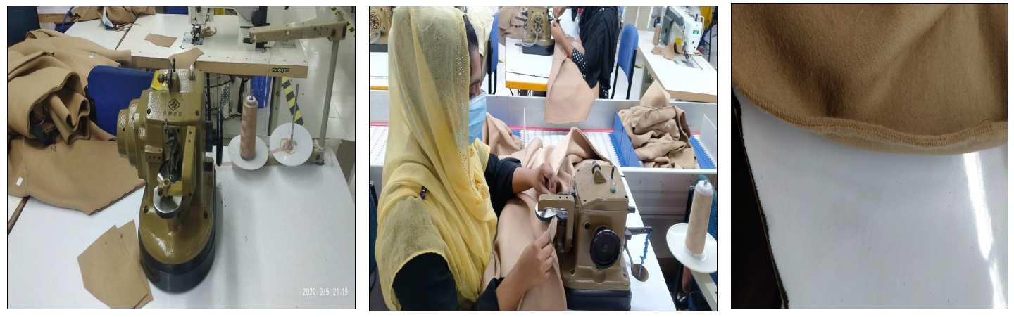
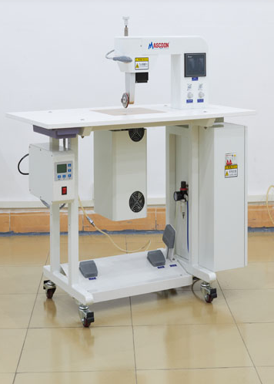
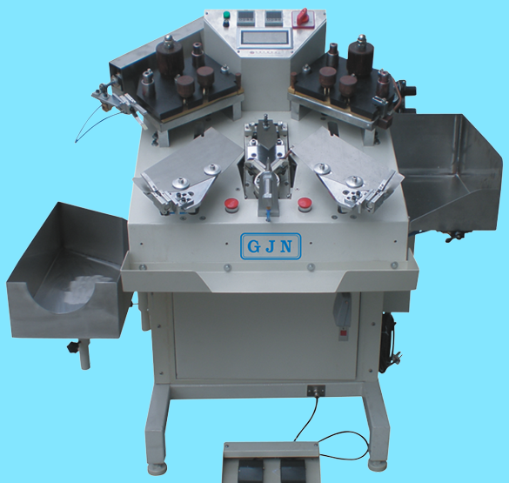
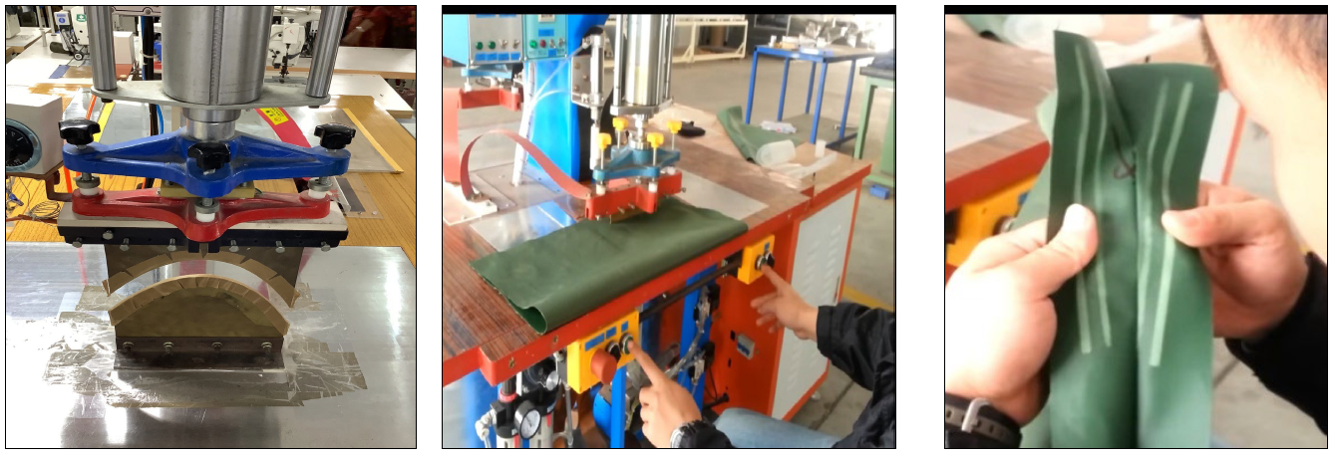
Debonair Latest Machineries – Debonair always emphasis on new innovation in production & process
A Ultrasonic edge cutting
Laser cut Machine
High frequency Embossing Machine
Pleat stitch/Cover stitch Machine
APW Laser Machine
Hydrostatic sotter test (Water) tester machine auto/semi auto
Automatic Pocket Setter Machine
Loop Setter Machine
Automatic Collar trimming & Corner press Machine
High frequency Embossing Machine
Real down Filling Machine
Auto Fake Down Crashing Machine
Heat Press Machine
Needle Smocking Kansai Machine
Velcro/Label Attaching Machine
Auto Template Sewing Machine
Template Design and Cutting Machine
Seam Sealing Machine
Heat Press Machine
Auto Cutting & Spreading Machine

Slide 10

Debonair is now highly flexible to The North Face requirements and Always positive to adopt the newness.

Slide 11
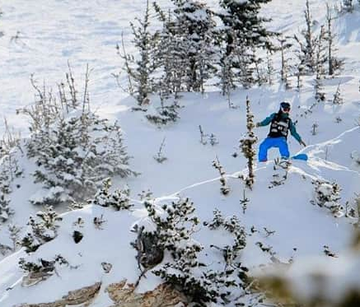

Cost Structure over the seasons for TNF
Season | Profit % (%) | Finance Fee | TCE ($/hour) | OH (%)
F23 TNF | 8.00% | 5.00% | $2.91 | 8%
S24 TNF | 7.00% | 3.00% | $2.91 | 8%
F24 TNF | 7.00% | 3.00% | $1.04 | 200%
VF Standard | 7.00% | 2.00% | $1.07 | 192%
Debonair New Alignment for S25 to onwards | 7.00% (Aligned) | 2.00% (Aligned) | $1.02 (Even Better) | 190% (Even Better)
Eff (%)
28%
31%
33%
60%
45%
LOH rate ($/min)
-
$0.17
$0.16
$0.09
$0.11

Slide 12



Material Freight lanes reduction
Debonair also aligned freight cost for S25 to onwards seasons.
Where brand asked to decrease 9% but Debonair deducted more than 9%.
Freight Cost | Earlier | New Aligned
Woven | $0.10 to $0.15 | $0.07
Knit | $0.25 | $0.18
Flecce | $0.40 | $0.25

Slide 13
FOB comparison with past seasons
VS new alignment
Style | S24 FOB | F24 FOB | Debonair New Alignment FOB as S25 | Difference | FOB Decreased %
A3LH4 | $38.63 | $35.95 | $31.96 | ($3.99) | -11.10%
A3LH5 | $35.40 | $32.77 | $28.95 | ($3.82) | -11.66%
A8711 | $21.34 | - | $18.19 | ($3.15) | -14.76%
A8710 | $21.53 | - | $18.38 | ($3.15) | -14.63%
A853L/A8BCJ | $40.73 | $41.34 | $36.62 | ($4.72) | -11.42%
A83QX | $28.86 | - | $23.38 | ($5.48) | -18.99%
A852U/A87CT | $27.36 | - | $23.86 | ($3.50) | -12.79%
A88Y4 | - | $28.04 | $24.67 | ($3.37) | -12.02%
A88ZA | - | $27.41 | $23.99 | ($3.42) | -12.48%
 |  |  | Avg. | ($3.84) | -13.32%

Slide 14

Thank you

